Slide 1

Aerodel: Autonomous drone for efficient and safe delivery
SCHOOL OF ELECTRICAL AND ELECTRONICS
DEPARTMENT OF ELECTRONICS AND COMMUNICATION ENGINEERING
PROJECT GUIDE
TEAMMATES
Dr. S. LAKSHMI M.E., Ph.D.,
MELVIN JOSHUA R - 41130314
MOULEESHWARA S- 41130327

Slide 2
AIM
The AERODEL project aims to develop an advanced autonomous drone capable of efficiently and safely performing last-mile deliveries.
This involves designing a robust navigation system that leverages supported by a user-friendly mobile application for route planning and monitoring.
The project seeks to overcome the limitations of traditional delivery drones by enhancing reliability, extending flight range, and simplifying user interaction, ultimately facilitating the widespread adoption of drone-based logistics solutions.

Slide 3
INTRODUCTION
Drones have revolutionized the logistics and transportation industry by offering efficient, fast, and cost-effective delivery solutions.
While many modern drone delivery systems focus on autonomous navigation, challenges such as GPS dependency, network issues, and regulatory restrictions make manual control a more reliable and practical approach for localized operations.
This project, "Aerodel: Autonomous Drone for Efficient and Safe Delivery," is designed to function as a manual-controlled delivery drone operated using a FlySky FS-i10 transmitter and FS-R10B receiver.

Slide 4
The system eliminates the complexity of autonomous navigation while ensuring precise and real-time human control. Additionally, the drone is equipped with ultrasonic sensors for obstacle detection, allowing the operator to avoid potential hazards during flight.
The drone integrates a lightweight delivery mechanism capable of carrying payloads up to 500 grams, making it ideal for small-scale delivery applications such as campus logistics, research experiments, and last-mile delivery services. By utilizing efficient power management and a KK flight controller, the drone ensures stable flight and controlled maneuvering.
This project aims to provide a simplified yet effective delivery solution, overcoming the limitations of autonomous systems while maintaining safety, efficiency, and reliability in real-world applications.

Slide 5
OBJECTIVE
The primary objective of this project, "Aerodel: Autonomous Drone for Efficient and Safe Delivery," is to develop a manual-controlled drone-based delivery system that ensures reliable, efficient, and secure transportation of small payloads (up to 500 grams).
Develop a Manual-Controlled Drone:
Utilize the FlySky FS-I10 transmitter and FS-R10B receiver for real-time human control.
Enable Safe and Stable Flight:
Integrate the KK flight controller for effective stabilization and maneuvering.

Slide 6
OBJECTIVE
Design a Lightweight Delivery Mechanism:
Ensure the drone can carry and release payloads efficiently while maintaining flight stability.
Enhance Usability and Practicality:
Make the system suitable for campus logistics, research applications, and last-mile delivery in controlled environments.
This project aims to offer a cost-effective and practical drone delivery system that balances efficiency, control, and safety, making it a viable solution for various delivery applications.

Slide 7
LITERATURE SURVEY
S.NO. | Title | Algorithm | Parameter Analysed | Draw Back
1 | Last-Mile Drone Delivery: Past, Present, and Future Author:Hossein Eskandaripour, Enkhsaikhan Boldsaikhan Year:2023 | This literature review discusses the key technical challenges in last-mile drone delivery, such as routing, cargo distribution optimization, battery management, data communication, and environmental protection. It provides insights into how drones can complement existing transportation methods and addresses the sustainability aspect of drone delivery systems | Routing efficiency cargo distribution battery management data communication environmental impact. | General overview without deep technical solutions potential lack of real-world application examples.
2 | Optimal Routing and Scheduling for Drone and Delivery Truck Collaborative System Authors:Murray and Chu Year:2021 | This study presents mathematical programming models for optimizing the routing and scheduling of drones and delivery trucks, exploring scenarios where drones collaborate with traditional trucks for parcel delivery. | Route optimization. Scheduling efficiency. Collaboration between drones and trucks. | Complexity in real-world implementation due to coordination between different modes. Potential delays in package transfers between drones and trucks.

Slide 8
S.N. | Title | Algorithm | Parameter Analysed | Draw back
3 | Energy Consumption Models for Multirotor Drones in Delivery Operations Author: Dorling et al Year: 2021 | This paper develops and validates an energy consumption model for multirotor drones used in delivery operations, focusing on optimizing drone routing to minimize energy use. | Energy consumption rates. Flight dynamics. Payload impact on energy usage | Models may not fully account for energy consumption variability in different weather conditions. Assumes constant battery performance which may degrade over time. Limited field validation of theoretical models.
4 | Development of a Control Strategy for Autonomous Delivery Drones Author: Almakhles et al Year: 2020 | Proposes a high-level control strategy for autonomous drones based on vector field guidance. The paper considers the drone's stability and trajectory control to ensure precise and safe delivery of packages, especially in urban areas where landing accuracy is crucial | Stability control. Trajectory accuracy. Landing precision. | Potential limitations in diverse urban environments, reliance on ideal conditions for vector field guidance.

Slide 9
S.N. | Title | Algorithm | Parameter Analysed | Draw back
5 | Optimization of Drone Delivery Systems for Urban Areas Author: Chiang et al. Year: 2019 | Focuses on optimizing route planning for drone deliveries in urban areas, considering factors such as optimal charging station locations and the integration of drone-carrying truck routes. This work aims to improve the efficiency and practicality of drone deliveries in densely populated environments | Route planning efficiency Charging station optimization, Integration with truck routes. | Focus on urban areas may not be applicable to rural settings, complexity in integrating with existing logistics systems.

Slide 10
EXISTING METHOD
The existing methodology for autonomous drone delivery systems integrates energy management strategies, hybrid delivery models, environmental impact assessments, infrastructure development, security protocols, and regulatory compliance.
These components collectively aim to optimize drone deliveries' efficiency, safety, and feasibility, paving the way for their widespread adoption in logistics and transportation.
Hybrid Models:
Combining drone deliveries with traditional delivery vehicles, such as trucks, to optimize the delivery process. Drones can be deployed from trucks to handle the last-mile delivery.
EXISTING METHOD DRAW BACKS
Current drone delivery systems are limited to GPS-friendly environments, making them unsuitable for seamless navigation in mixed indoor-outdoor settings and preventing precise indoor deliveries.

Slide 11
BASE PAPERS
Title: Learning–Based Cooperative Mobility Control For Autonomous Drone Delivery
Authors: Soohyn Park ,Chanyoung park and Joonghen Kim
Published Year: April 2024
Summary:
The work focuses on developing an algorithm for autonomous multi-drone aerial package delivery, aiming to maximize the number of delivered packages and optimize energy utilization to prevent battery exhaustion.
This scheduling optimization problem is transformed into a multi-agent deep reinforcement learning (MADRL) task. The proposed solution involves a novel communication network (CommNet)-based algorithm to facilitate cooperation among multiple drones.
The performance evaluation of this CommNet-based algorithm demonstrates improvements in the number of delivered packages and efficient energy usage.
Link: https://www.ieee.org/publications/rights/index.html

Slide 12
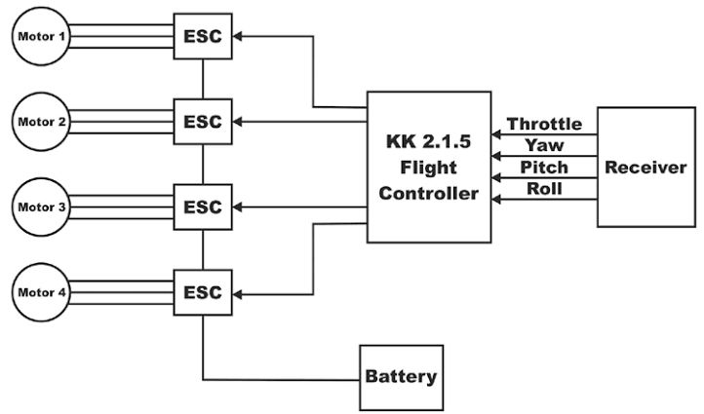
PROPOSED METHOD

Slide 13
PROPOSED METHOD
Route Planning and Training
Initial Route Training: Use the companion mobile app to select source and destination points. Train the drone on these routes to ensure familiarity and efficiency during autonomous operation.
User Interface Development
User Interface: Develop a user-friendly mobile application that allows users to select source and destination points, monitor the drone's status in real-time, and receive notifications.
Performance Optimization
Battery Management: Implement power management strategies to optimize battery usage and extend flight time.

Slide 14
PROPOSED METHOD
System Design and Framework
Frame and Structure: Design a lightweight and sturdy frame capable of supporting a payload of up to 600gm. Materials such as carbon fiber or lightweight aluminium alloys will be used to ensure durability without compromising flight performance.
Navigation and Control System
Autopilot Integration: Utilize open-source autopilot software like ArduPilot or PX4. Customize this software to optimize route planning and autonomous control, ensuring reliable and precise navigation.

Slide 15
WORKING PRINCIPLE
Autonomous Navigation: The drone autonomously navigates through predefined waypoints using onboard sensors and GPS for accurate positioning.
Waypoint Mapping: Location mapping code allows the drone to calculate routes from source to destination, moving step-by-step through designated waypoints.
Lightweight Load Capacity: Designed to carry packages up to 500 kg, making it suitable for small deliveries.
Obstacle Avoidance: Integrated sensors detect obstacles and adjust the drone’s path, ensuring safe movement through mixed environments.
Automatic Return to Base: After completing delivery, the drone returns to the starting point or designated base, ready for the next operation.
Automatic Landing: Incase of any emergency it will automatically started to land in the ground.

Slide 16
WORK DONE SO FOR
Acquire and Test Components:
- Procured essential components: flight controller, GPS, battery, sensors.
- Confirmed compatibility and tested each component’s functionality.
Construct Drone Structure:
- Assembled main frame and mounted motors and propellers.
- Verified structural stability and component alignment.
Flight Controller Configuration:
- Calibrated KK Flight Controller using software
Configured motor directions and ESC settings
Tested receiver inputs and transmitter control signals

Slide 17
WORK DONE SO FOR
Failsafe & Safety Features:
- Implemented Failsafe Landing (Signal Loss) mechanism
- Ensured automatic descent upon signal failure
- Verified ultrasonic sensors for obstacle detection
Testing & Troubleshooting:
- Conducted motor test runs without flying
- Fine-tuned PID settings for stability
Fixed hardware and software issues
Documentation and Demo:
-Document configurations and prepare a demonstration for the project guide.

Slide 18
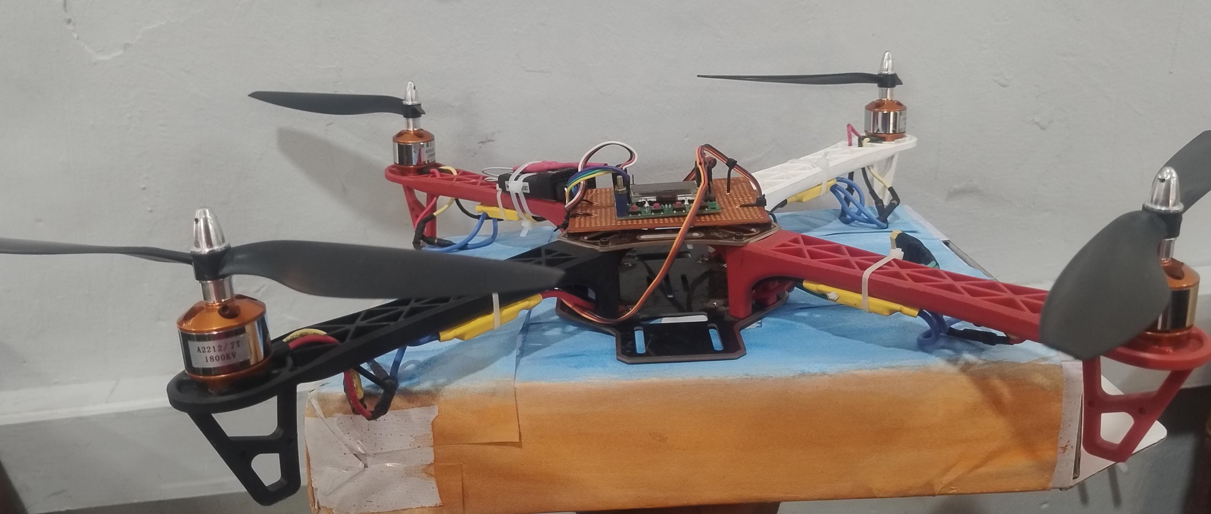
WORK DONE SO FOR
Aerodel delivery drone, capable of carrying up to 500g

Slide 19
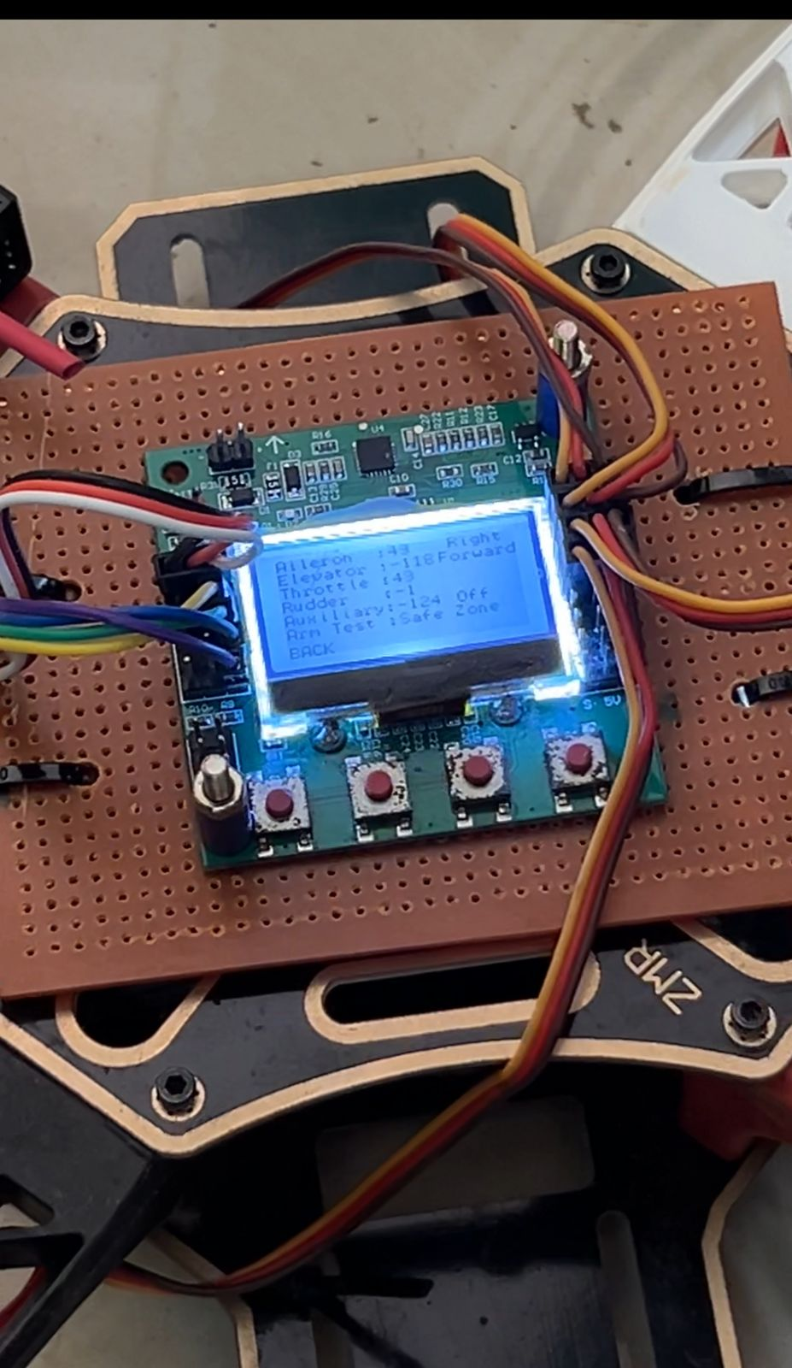
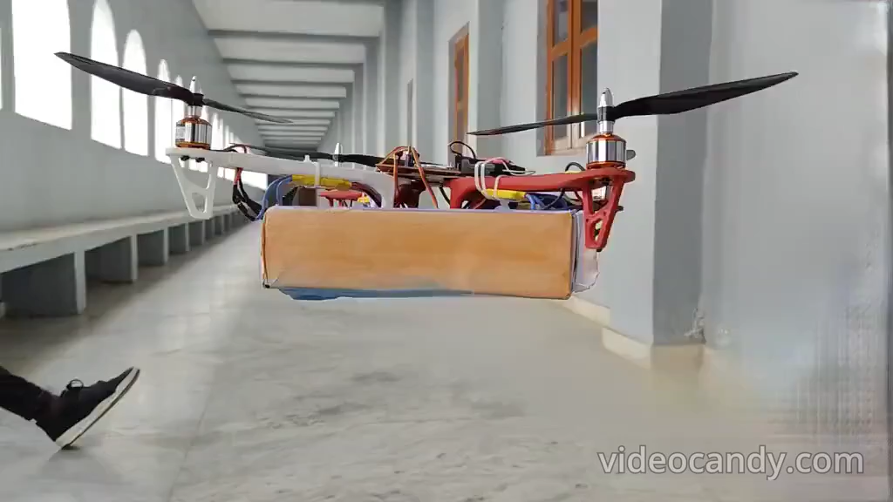
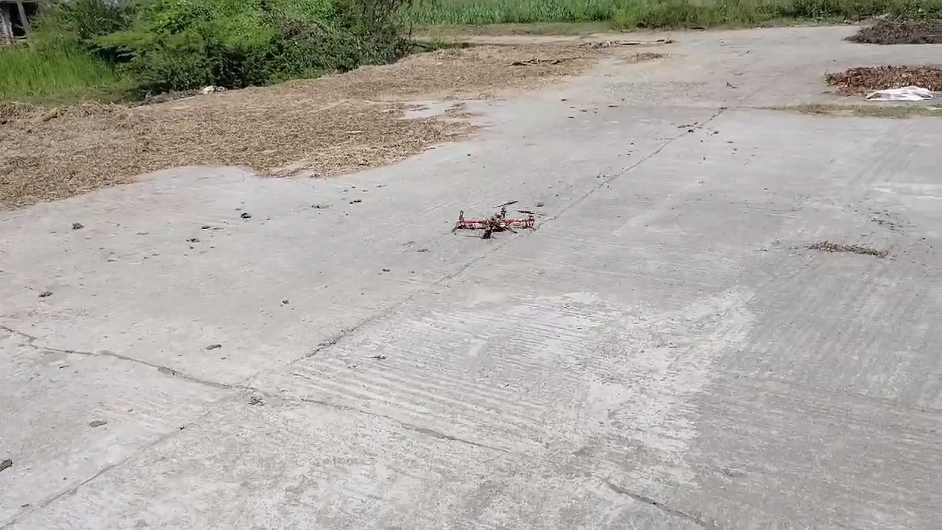
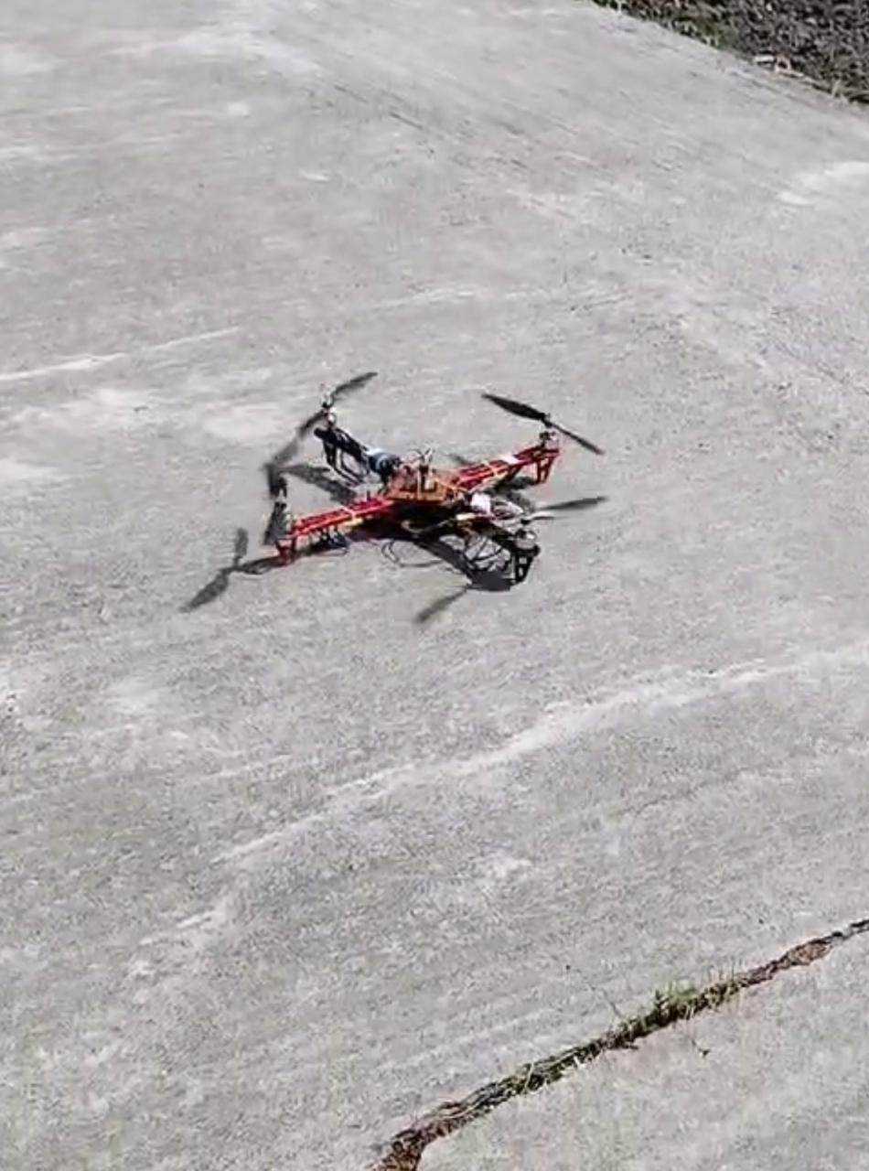
WORK DONE SO FOR
Calibrating Values in Multi Quad
Copter
Initial take off video after calibration
Failsafe landing incase off any
problem

Slide 20
USE OF THIS DRONE
Small parcels and documents (e.g., letters, reports, or confidential files)
Medical supplies (e.g., first aid kits, medicines, or small medical equipment)
Food and beverage items (e.g., packaged meals, drinks, or groceries)
Electronic components (e.g., small sensors, microcontrollers, or tools for research)
Educational materials (e.g., books, exam papers, or lab samples)
Uses of This Drone

Slide 21
USE OF THIS DRONE
Campus and Institutional Deliveries:
Transport documents, lab samples, or research equipment within a university or research facility.
Medical and Emergency Assistance:
Deliver first aid kits or essential medicines in a timely manner.
Event and Remote Locations:
Supply lightweight items to locations where ground transportation is difficult or slow.
Research and Development:
Used as a testbed for studying drone control, obstacle avoidance, and delivery mechanisms

Slide 22
REFERENCES
Agüera, J. (2018). *Unmanned Aerial Vehicles (UAVs) for commercial applications: A review*. Journal of Unmanned Vehicle Systems, 6(3), 133-146.
Anderson, C. (2012). *Makers: The new industrial revolution*. Crown Business.
Bashiri, M., & Homaifar, A. (2019). *Autonomous delivery drones: Design and implementation challenges*. IEEE Transactions on Automation Science and Engineering, 16(1), 245-254.
Bogue, R. (2018). *What are the prospects for autonomous drones in logistics?*. Industrial Robot: An International Journal, 45(2), 131-138.
Guo, X., Zhang, J., & Li, Z. (2017). *Path planning and obstacle avoidance for autonomous drones*. International Journal of Robotics and Automation, 32(4), 291-301.
He, X., & Li, W. (2019). *Autonomous drone delivery systems: Opportunities and challenges*. Proceedings of the IEEE International Conference on Robotics and Automation, 4567-4573.
Li, X., Liu, Z., & Li, T. (2020). *Advanced control systems for autonomous drone delivery: A review*. Journal of Control and Decision, 7(1), 15-29.

